Slide 1

Hack The Box
Red Trails

Slide 2

About the box
Red Trails
Medium Level challenge.
The challenge is Related to forensic analysis.
Notes:
Talk what is Redis protocol : what is it and what is used in general.

Slide 3

NETWORK ANALYSIS & DECRYPTION TOOLS
Notes:
Here talk about what is network analysis and why do we need to do it. What role it play in the cybersececurity

Slide 4

SNORT
Snort is an open-source network intrusion detection and prevention system (IDPS).
It monitors network traffic in real-time to identify and respond to malicious activity such as unauthorized access, malware, and denial-of-service attacks.
Snort uses a rule-based approach to detect threats by comparing traffic patterns against known attack signatures
Notes:
Tool 1 used for network analysis

Slide 5
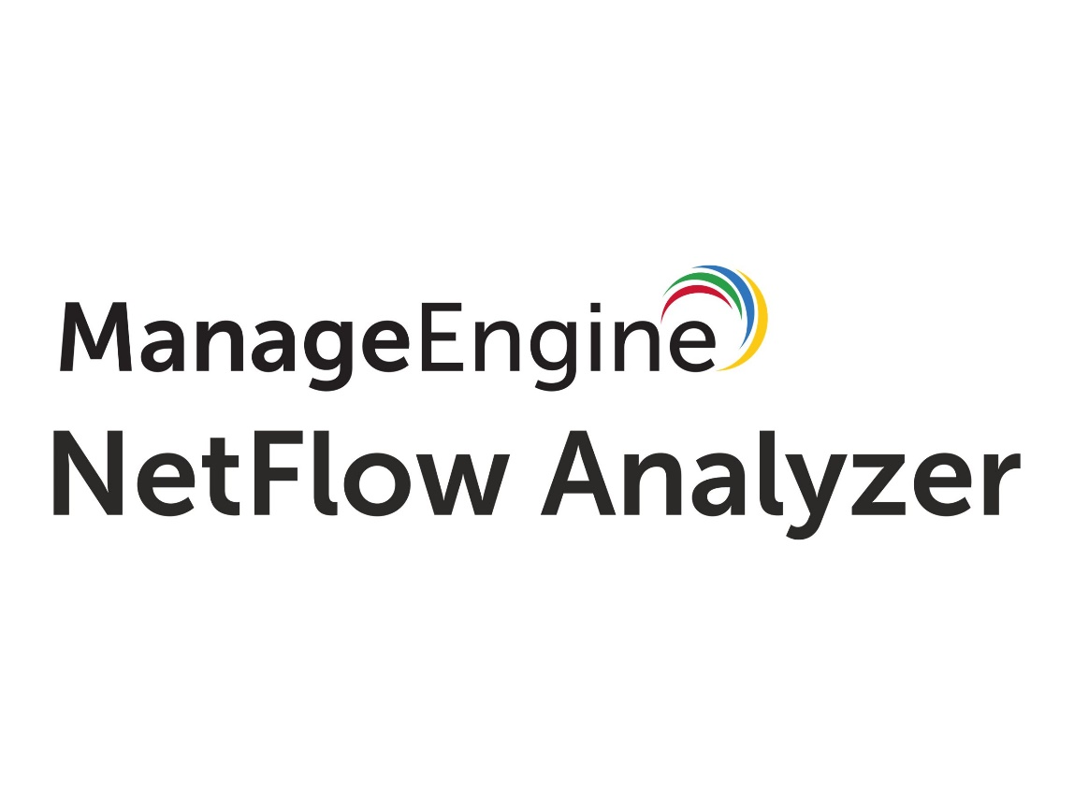
NET FLOW ANALYZER
This is a tool that monitors and analyzes network traffic patterns using flow data to track bandwidth usage and detect anomalies.
It can be used to identifies security threats like unusual traffic or malicious activity and supports incident investigation with detailed network logs
Notes:
Tool 2

Slide 6

WIRESHARK
Wireshark is a powerful, free, open-source network protocol analyzer. It captures and dissects network traffic, allowing you to inspect individual packets in detail. This helps troubleshoot network issues, analyze security incidents, and understand network protocols
Using the tool Wire shark we examined packets captures (PCAPFiles) to check data exfiltration, unauthorized access or other malicious activity using Redis protocol.
Notes:
Tool 3: wireshark or we can use TCPDUMP which is cli based.

Slide 7

GHINDRA
Ghidra, a powerful reverse engineering tool, aids in deciphering encrypted data within malware and other malicious files.
By analyzing assembly code, it reveals decryption algorithms and keys, enabling security analysts to understand and mitigate threats.
Notes:
Ghindra is opensource and IDA is commerical and industrially used for decompiling and dissassemblying the code.

Slide 8

IDA PRO
IDA Pro is a powerful tool for reverse engineering and malware analysis. It can be used to analyze binary code, identify vulnerabilities, and decrypt encrypted data.
IDA Pro can be used to analyze a wide variety of file formats, including executables, libraries, and firmware
But it is Paid ☹

Slide 9
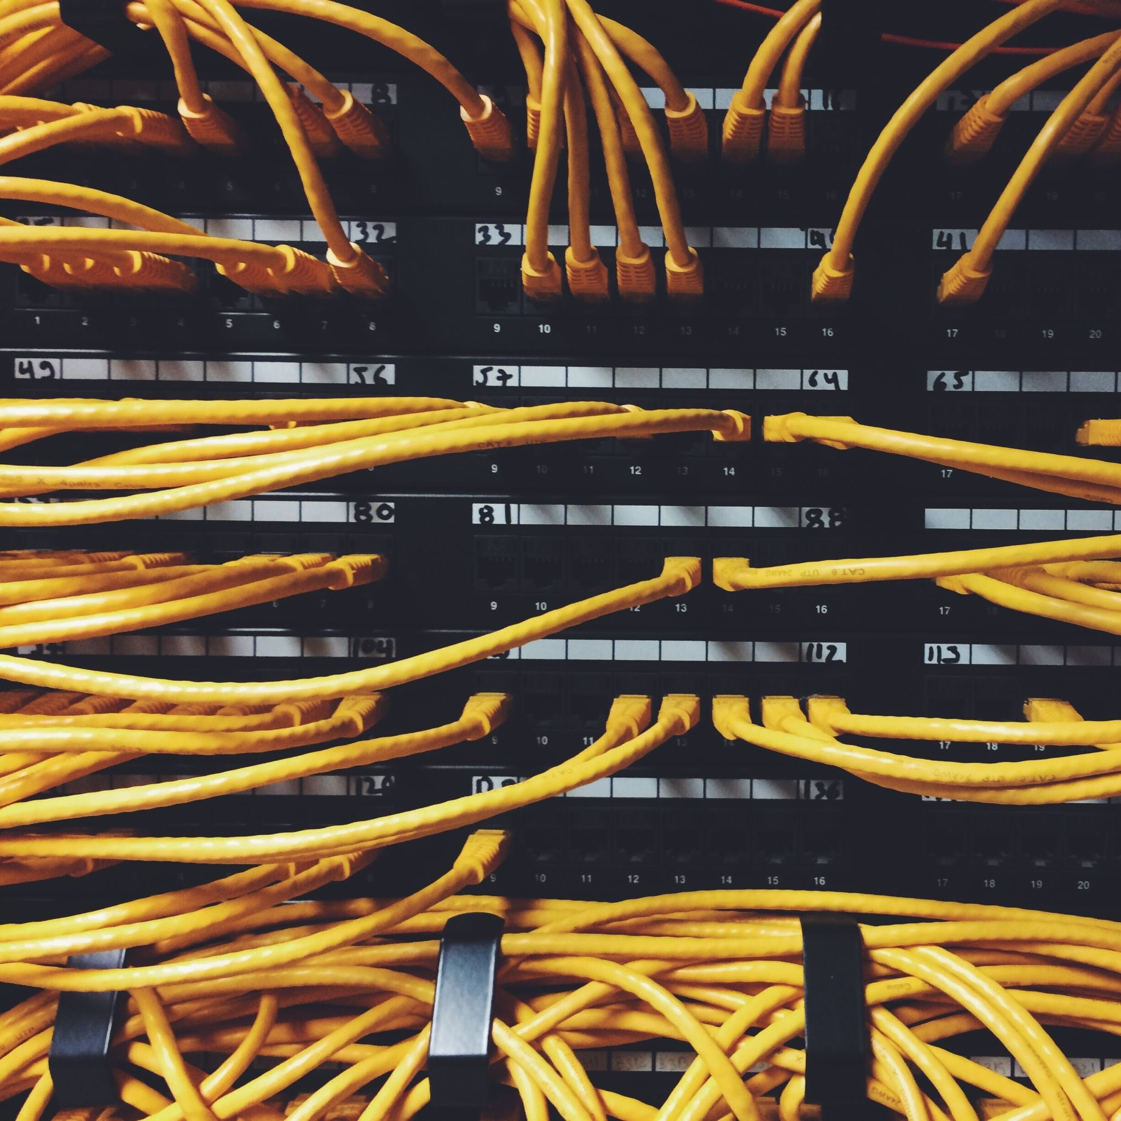
Step 1: Downloaded the .pcap file on the kali box.
Step 2: Analyzing the for strings in the file using strings command

Slide 10
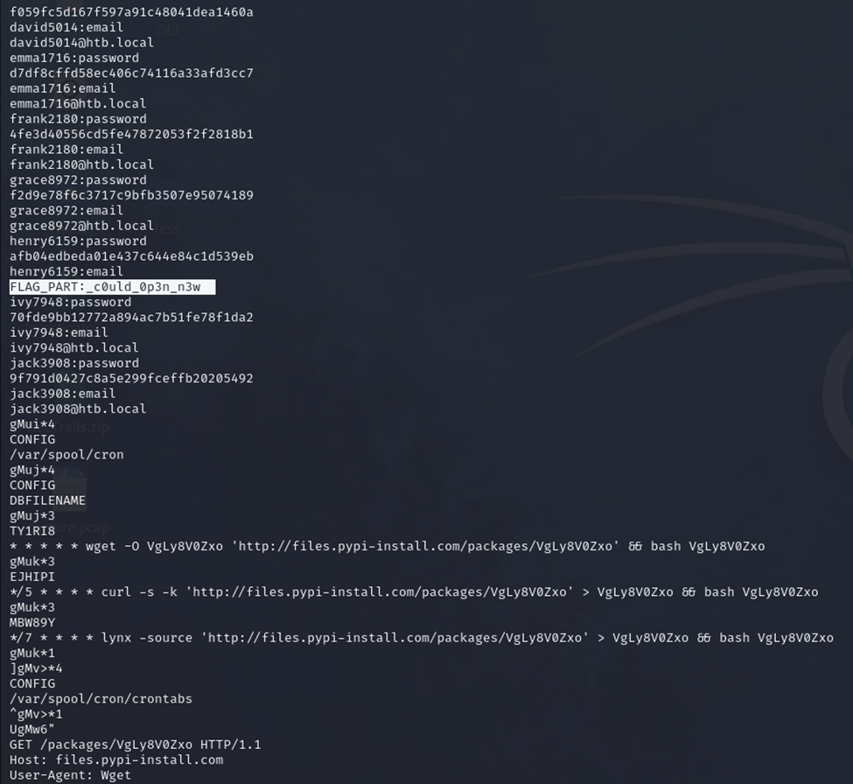
Flag 1
The following command helped us find the first FLAG (1 out of 3).
Strings Syntax: strings [OPTION]... [FILE]... Command : string –n 6 capture.pcap
Going through the output we are able to find one of the flag part .
Notes:
Explain what is strings command and give one example for it and look for different options it has use chatgpt.

Slide 11
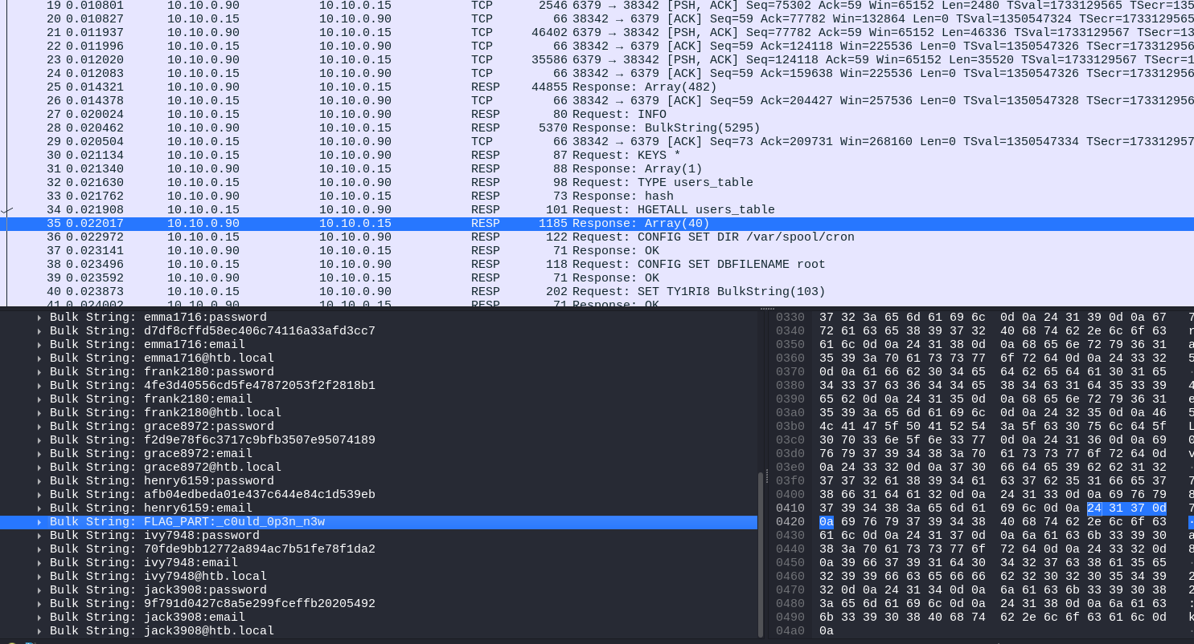
Method 2
We opened the file wireshark.
As the box is related to Redis protocol. We tried searching packets realted to it and found the same flag we found using 'strings'

Slide 12
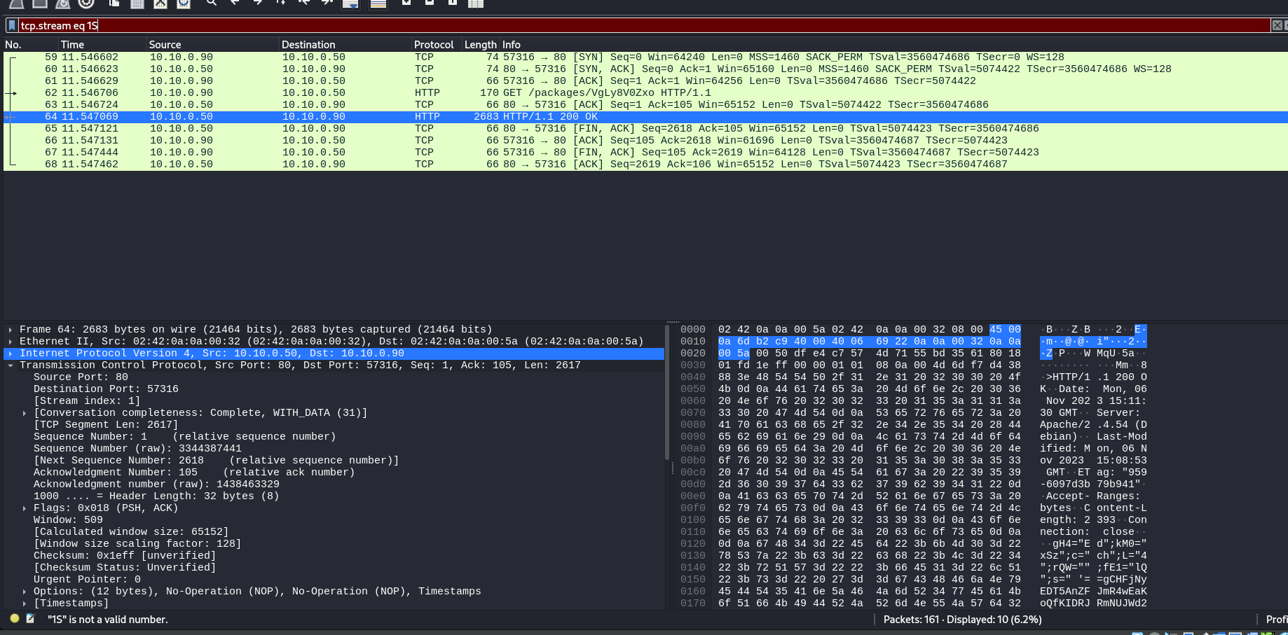
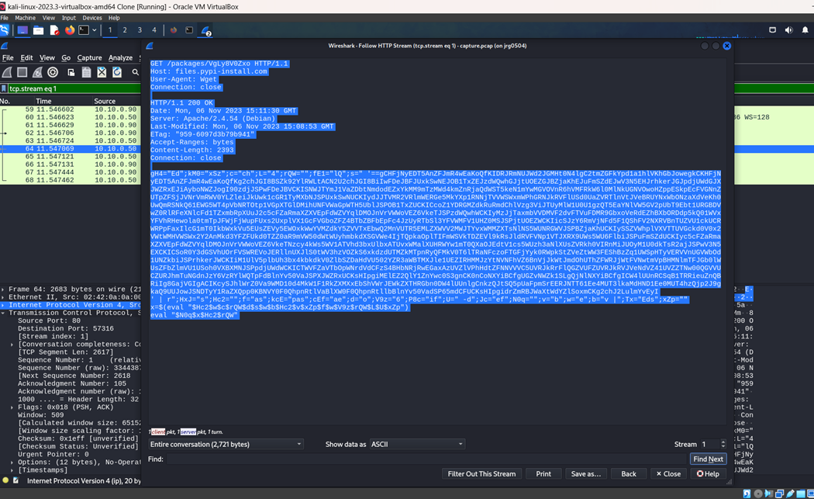
Flag 2
Next we checked the http request for any clue's.
Found encoded text which is sent using http, which we found odd due it length for server status request:
Notes:
Expalin what is tcp.stream eq1 , eq2 … what are they

Slide 13
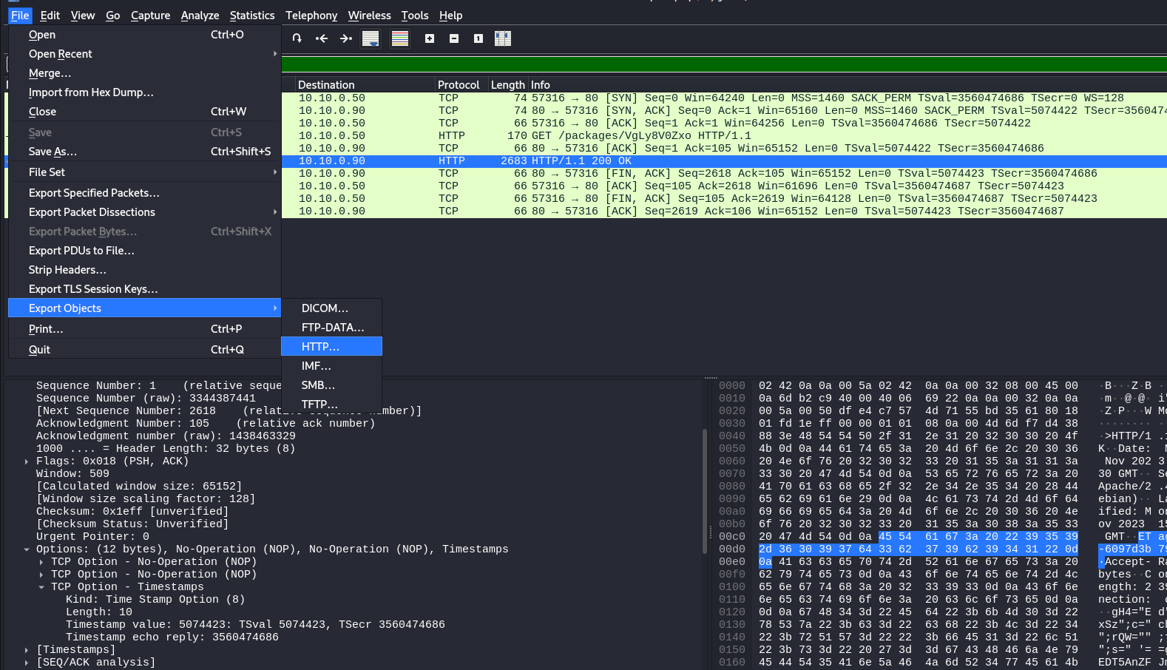
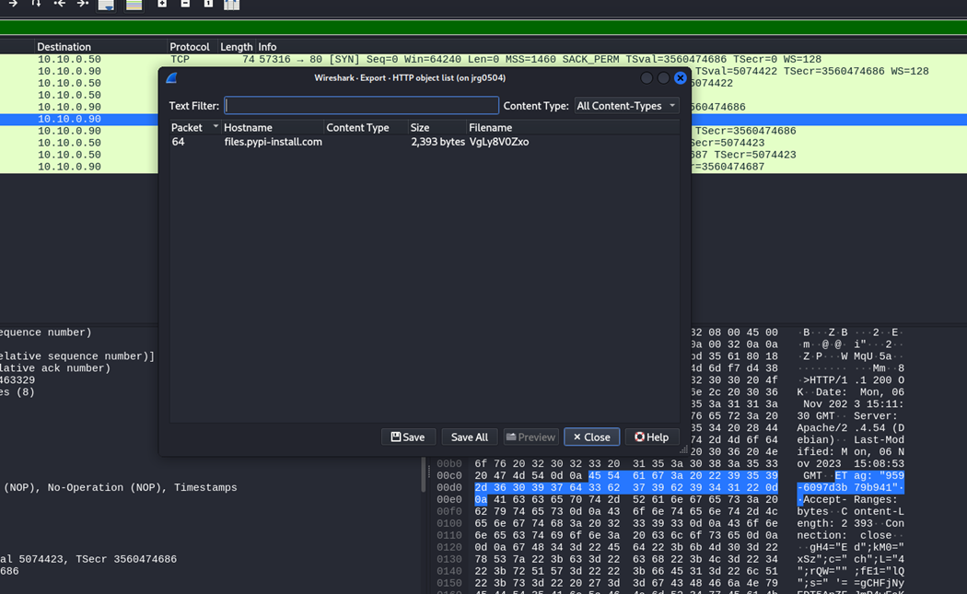
FLAG 2
Now we exported the http packet which is transferred as a part of request.

Slide 14
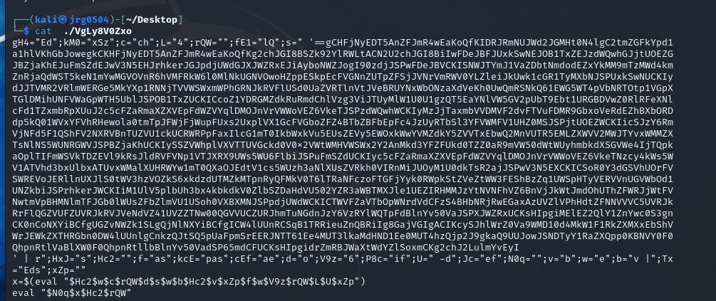
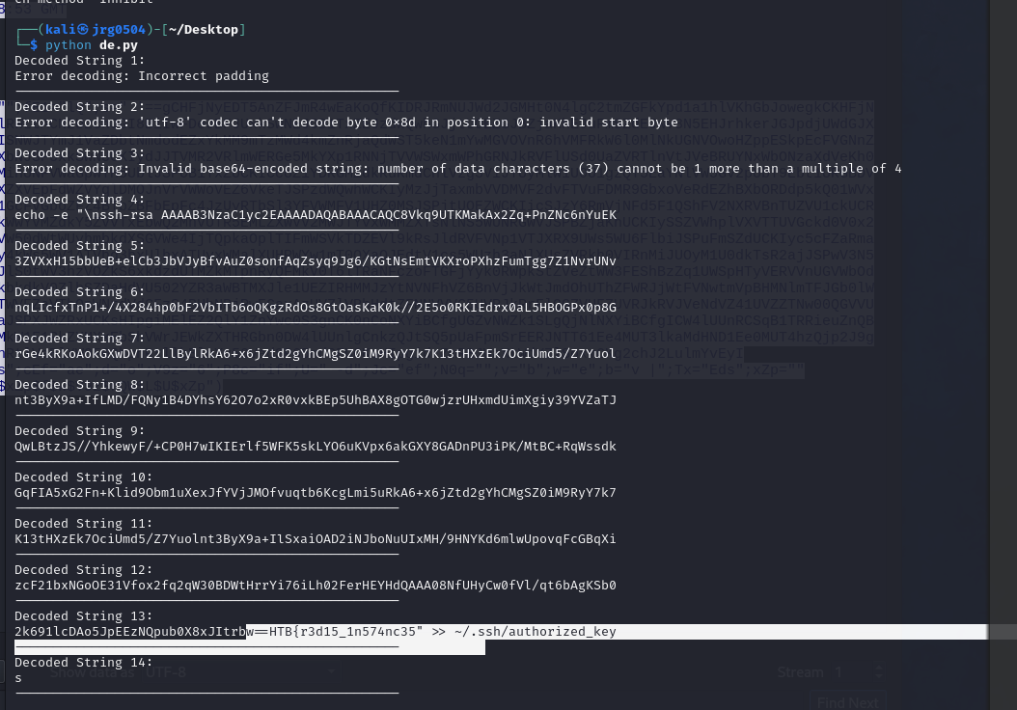
Flag 2
Used chatgpt to figure out what this piece of info was and identified as base 64 .
Then we wrote a program to decode the above base64 text and we were able to get the other part of the flag
So, we found part 2 of the 3 of the flag
Notes:
Talk about type of formats like base64, unicode etc used in nexwork packets.

Slide 15
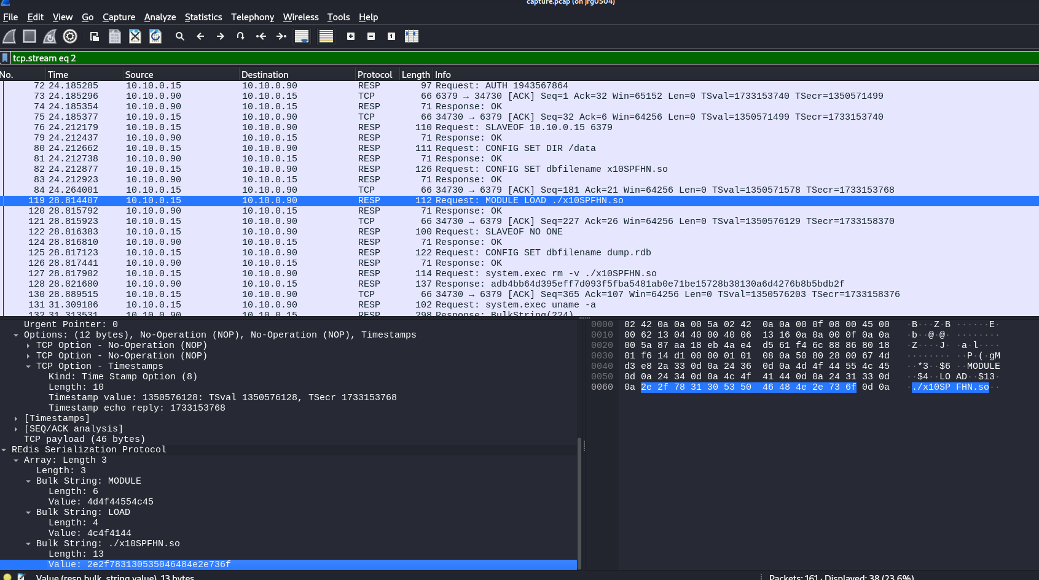
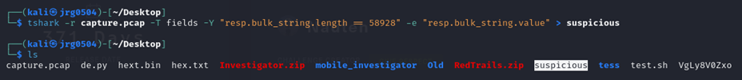
Flag 3
We found following string : “%2hhx
h02B6aVgu09Kzu9QTvTOtgx9oER9WIoz
YDP7ECjzuV7sagMN
%02x” which looked odd.
So, we the below command and saved the packet in a separate file.
After going to through the suspicious file and though of decompiling the file. So we went back to wireshark and saved the payload as hex stream and created the sharable object file and opened it using Online Decoder to decode the base 64 text.
Notes:
Talk about what is tshark

Slide 16

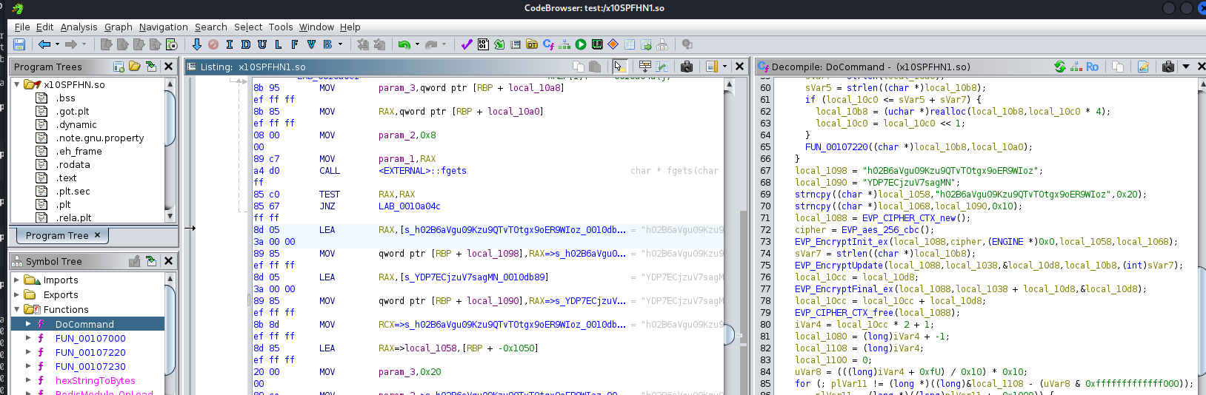
Flag 3
Below is the code and in one of the function called do command we can see key and iv used by the aes crypto algorithm which are used to encrypt something when transferring the data.

Slide 17
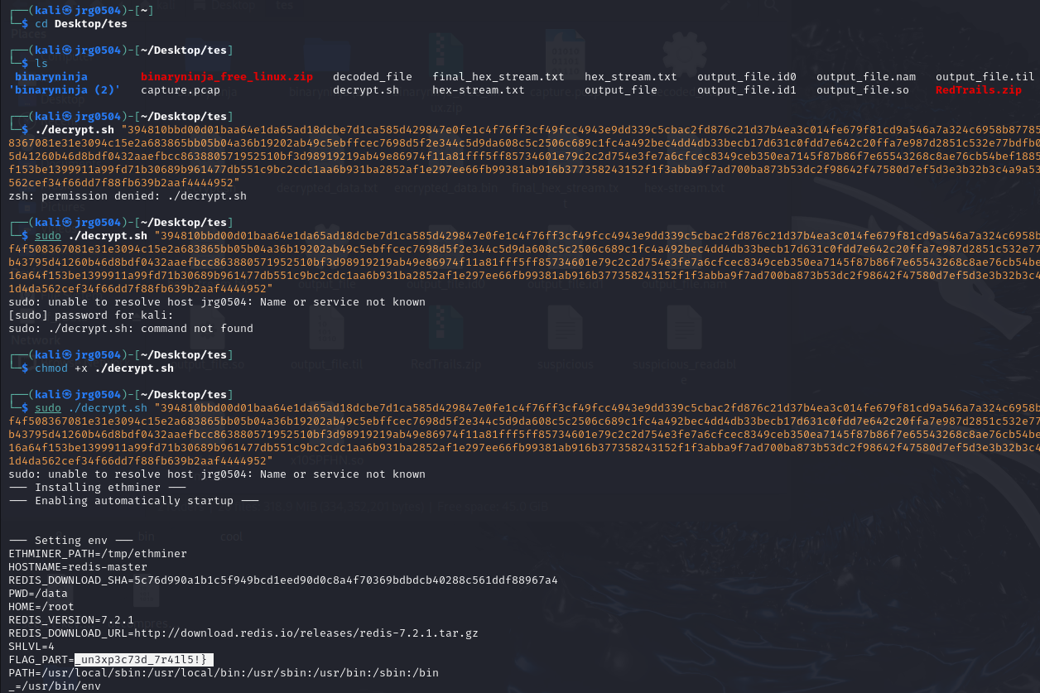

Flag 3
Now created bash file to decrypt the payload using the key we found, and we finally found the last part of the key:

Slide 18

FLAG 3
Decrypt.sh code:
#!/bin/bash
# Convert key and iv to hex
key="$(echo 'h02B6aVgu09Kzu9QTvTOtgx9oER9WIoz' | tr -d '\n'| xxd -p | xargs | tr -d '\ ')"
IV="$(echo 'YDP7ECjzuV7sagMN' | tr -d '\n'| xxd -p | xargs)"
echo "$1" | xxd -r -p > encrypted_data.bin
# Decrypt using OpenSSL
openssl enc -aes-256-cbc -d -in encrypted_data.bin -out decrypted_data.txt -K "$key" -iv "$IV" -nopad
cat ./decrypted_data.txt

Slide 19

Group 3
* Jayanth Reddy Gajjala
*Kiran Sahu
*Samhitha Renati
*Lokesh Harinath Gorintha
*Random guy in the DP Library

Slide 20
Thank you

Slide 21
Reference:
IDA : ida-free
Wireshark: Wireshark · Go Deep
TCPDump: Home | TCPDUMP & LIBPCAP
Strings: How to Use the strings Command on Linux
Ghindra: Ghidra
GitHub - NationalSecurityAgency/ghidra: Ghidra is a software reverse engineering (SRE) framework
Types of Network Protocols and Their Uses - GeeksforGeeks
Demystifying Common Encoding Techniques - Blue Goat Cyber

